Slide 1

Science Gateway Architectures
January 11th, 2019
Suresh Marru, Marlon Pierce
smarru@iu.edu, marpierc@iu.edu

Slide 2
Todays Outline
What To Expect
Project Teams
Microservices
Project Themes
Open Discussion

Slide 3
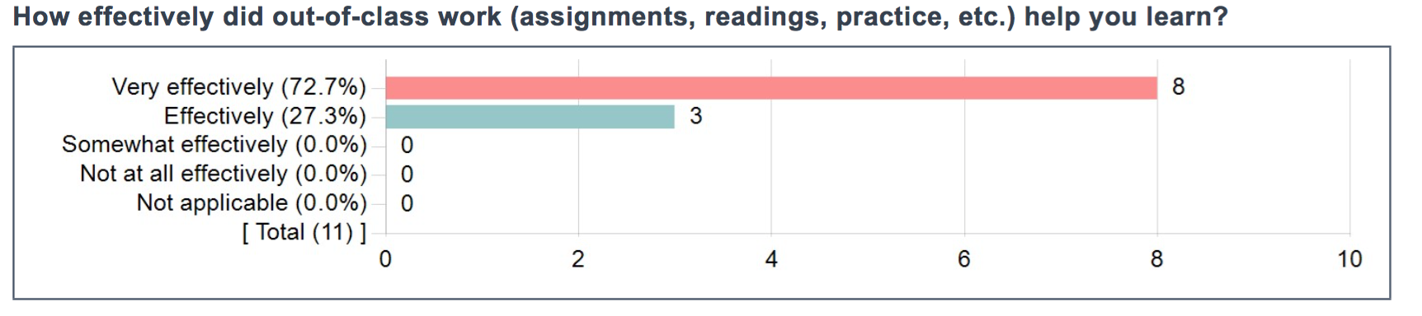
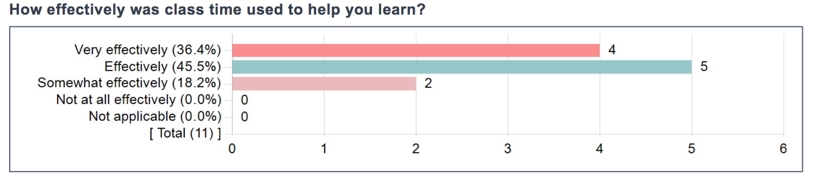

Slide 4
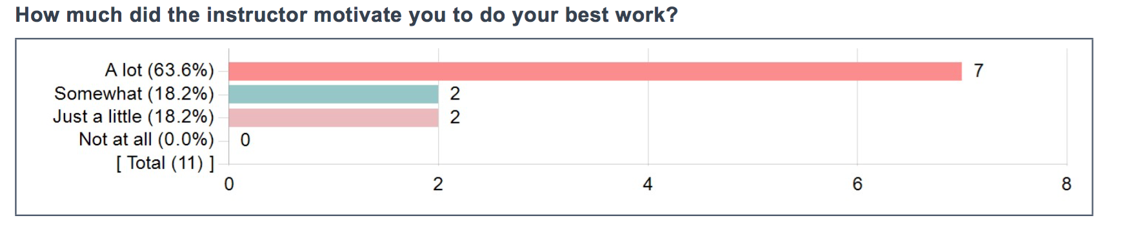
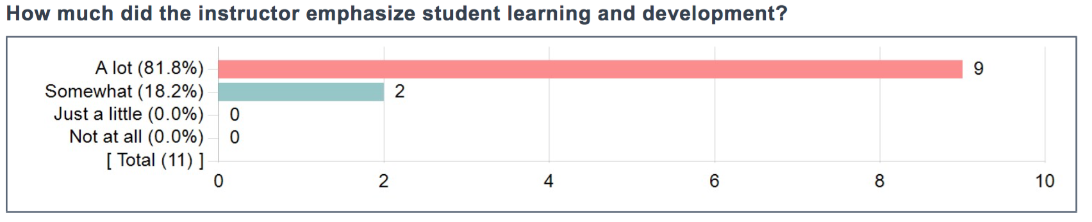

Slide 5
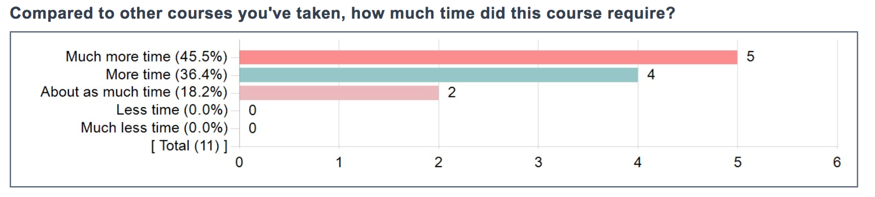
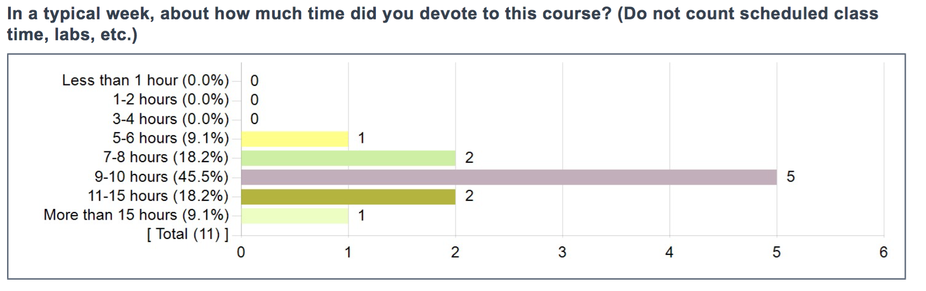

Slide 6
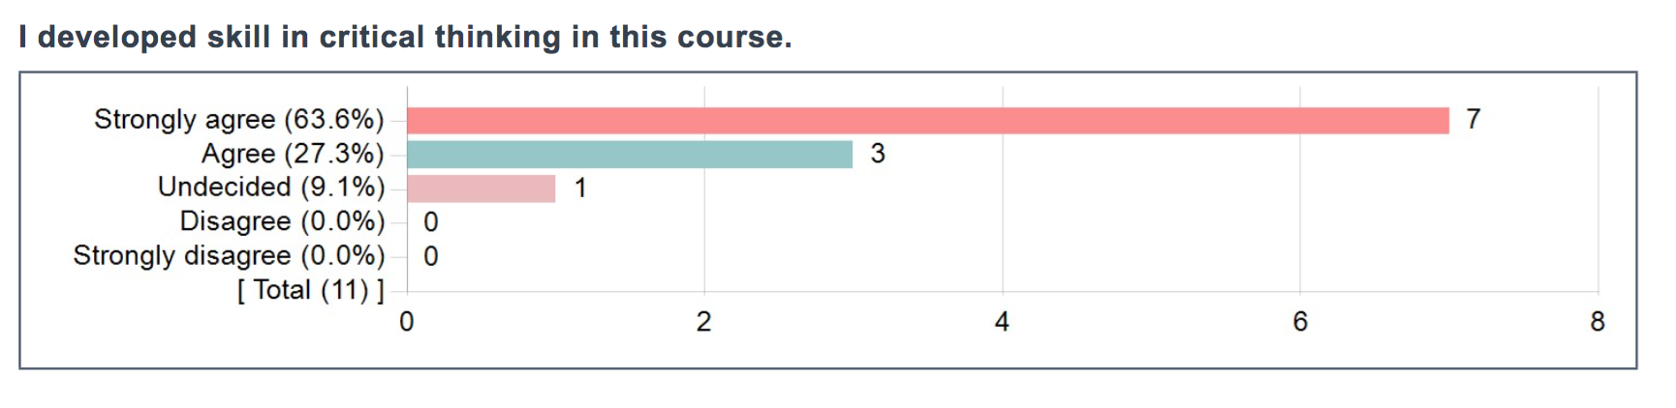
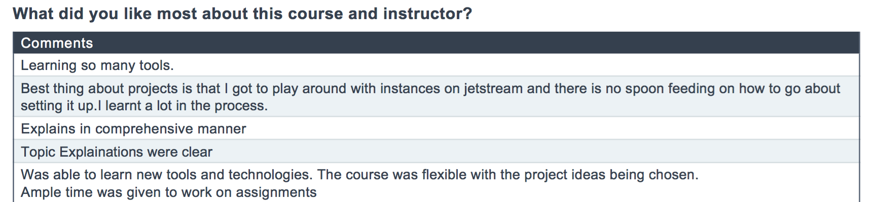

Slide 7
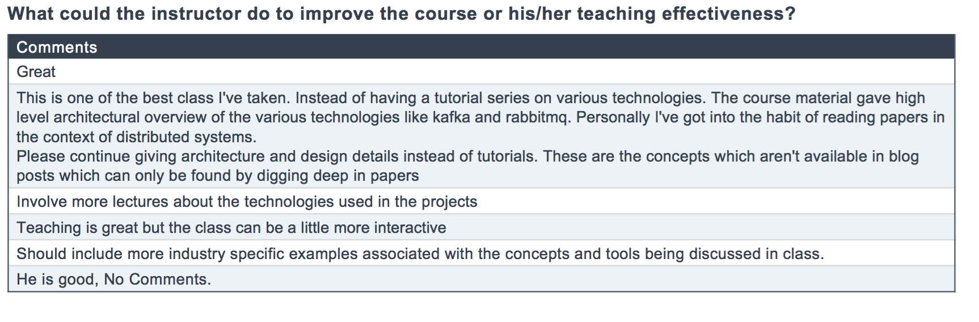

Slide 8
In Summary...
We expect you to do a lot of work for the class
But we expect you will find the class challenging, rewarding, and enjoyable
Make your semester plans accordingly
We’ll offer the class again in Spring 2020

Slide 9
Science Gateways Research Center
Accelerate research, discovery and scientific collaboration through the creation, integration, and operation of systems that combine distributed software, data, and infrastructure resources into user environments that serve and enable scientific communities. Advance the broader cyberinfrastructure community through education, training and sharing knowledge.

Slide 10
Example Science Gateway

Slide 11

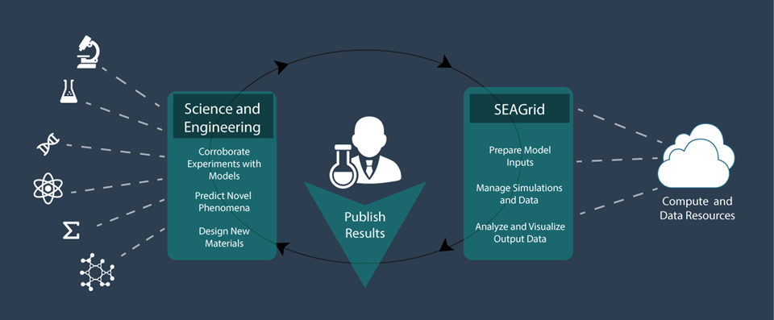
SEAGrid.org is an Apache Airavata-powered gateway

Slide 12
Hydrated Calcium Carbonate in Action

Slide 13
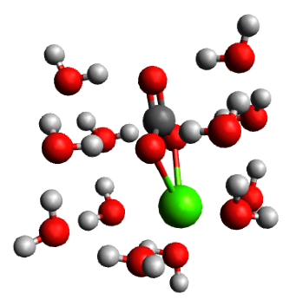
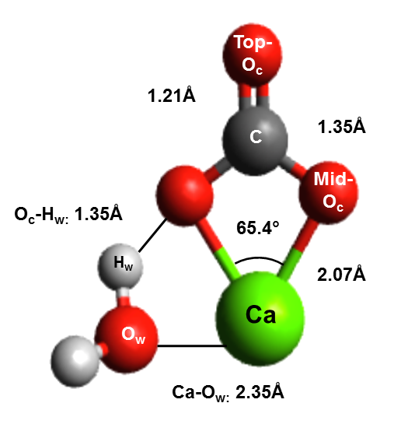
What is the chemistry of hydrated calcium carbonate?
Bio-mineralization of skeletons and shells
Geological C02 sequestration
Cleanup of contaminated environments
Lopez-Berganza, et al. J Phys. Chem. A(2015)
CaCO3.1H2O
CaCO3.12H2O
Notes:
If we go back to the earliest stages, during the ion pair formation, it is believed that the hydration shell around these minerals can dictate which pathway to is followed. Of course, study of hydration shell is challenging in the lab, so we rely on computational chemistry. For this particular study, we focused on thoroughly characterizing the hydration shell of calcium carbonate at different hydration levels. We hydrated a single molecule. We work with static structures. One of the practical challenges of this is how do we place water molecules to find the equilibrium states?
Biomineralization is a process by which minerals from nature are incorporated into biological systems for a variety of functions. Calcium carbonate is an abundant mineral extracted from calcium and carbonate ions in solution and used by many organisms to support critical functions such as structural entities such as skeletal systems and functional entities as protective layers. A specific aspect of self-healing of these tissues is interesting and should be applicable in engineered processes. In this study, we attempt to provide the thermodynamics of hydration of the mineral calcium carbonate in terms of the water coordination and ionic interactions. Ab initio quantum chemical simulations of large hydrated calcium carbonate clusters are challenging due to the existence of multiple local energy minima. SEAGrid Science Gateway and the applications deployed and provided to the community were used for this project for preprocessing, computations and post processing work.
Extensive conformational searches around hydrated calcium carbonate clusters (CaCO3·n H2 O for n = 1− 18) were performed to find low-energy hydration structures using an efficient combination of Monte Carlo searches, density-functional tight binding (DFTB +) method, and density-functional theory (DFT) at the B3LYP level, or Møller−Plesset perturbation theory at the MP2 level. This multilevel optimization yields several low-energy structures for hydrated calcium carbonate. Structural and energetics analysis of the hydration of these clusters revealed a first hydration shell composed of 12 water molecules. Bond-length and charge densities were also determined for different cluster sizes. The solvation of calcium carbonate in bulk water was investigated by placing the explicitly solvated CaCO3·n H2 O clusters in a polarizable continuum model (PCM) of water. The findings of this study provide new insights into the energetics and structure of hydrated calcium carbonate and contribute to the understanding of mechanisms where calcium carbonate formation or dissolution is of relevance.

Slide 14

CaCO₃.xH₂O Initial guess
SEAGrid.org enabled workflow
Stampede Supercomputer
TINKER
Monte Carlo Molecular Mechanics
(Minimize Torsional Energy in <20,000 steps)
Stampede Supercomputer
DFTB+
Approximate DFT-Based
x=x+1
-2-3 CaCO3 Equilibrium Structures
-Thermochemistry (E,H,G, etc.)
-Vibrational Frequencies
Comet Supercomputer
Gaussian09
Ab initio Quantum Chemistry
Lopez-Berganza, et al. J Phys. Chem. A(2015)
Notes:
Our approach uses a combination of MM to identify low energy candidates(which avoids any water placement bias). These candidates were then further optimized with more rigorous methods(DFTB+ and Gaussian 09). This approach gave us not only equilibrium structures, but also the thermochemistry of the clusters.

Slide 15
Browser
HTTPS
Web Interface Server
Client SDK
HTTP or TCP/IP
Server SDK
Application Server
Resource Plugins
IU: Big Red 2
XSEDE: Stampede
XSEDE: Comet
Juelich: Jureca

Slide 16
Challenges for Science Gateways
Providing a rich user experience
Defining an API for the application server
Defining the right sub-components for the application server.
Implementing the components, wiring them together correctly.
Supporting multiple gateway tenants
Fault tolerance for components
State management
Continuous delivery
Security management
Supporting full scientific exploratory cycle

Slide 17
Goal 1: Apply basic distributed computing concepts to Science Gateways.

Slide 18
Goal 2: Apply new architectures, methodologies, and technologies to Science Gateways: Microservices, DevOps

Slide 19
Goal 3: Teach open source software practices

Slide 20
Why Do We Teach This Class?
We are looking for students who like what we do and want to contribute to Apache Airavata.

Slide 21

What Is Apache Airavata?
Open source middleware to support Science Gateways
Compose, manage, execute, and monitor distributed, computational workflows
Wrap legacy command line scientific applications with Web services.
Run jobs on computational resources ranging from local resources to computational grids and clouds
Record, preserve, search, and share metadata about computational experiments
Hosted version of Apache Airavata provides multi-tenanted Platform as a Service.
SciGaP

Slide 22
What You Need to Do Before Next Class
Create a GitHub account if you don’t have one
Send us your GitHub user name so that we can add you to the Airavata Courses GitHub organization
Go to https://portal.xsede.org/ and create an account
Send us your user name
If possible, please make these user names consistent with your IU network ID.
Submit this through Canvas (0-point assignment)

Slide 23
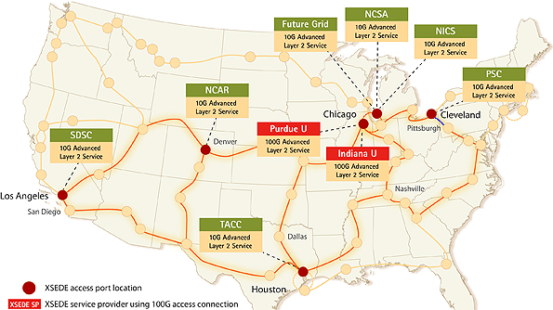

Slide 24

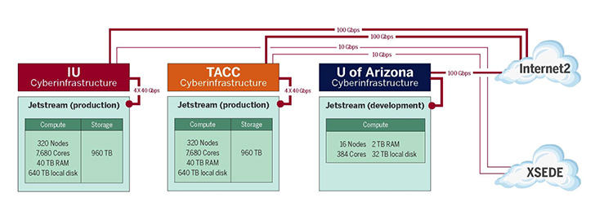
Science Engineering Cloud based on OpenStack

Slide 25
Monolithic Applications: Traditional Software Releases
Software releases occur in discrete increments
Software runs on clients’ systems
Releases may be frequent but they are still distinct
Firefox
OS system upgrades
Traditional release cycles
Extensive testing
Alpha, beta, release candidates, and full releases
Extensive recompiling and testing required after code changes
Code changes require the entire release cycle to be repeated

Slide 26
MicroServices: Software as a Service
Does your software run as a service?
Do you run this service yourself? Or does another part of your organization run the service that your team develops?
Traditional release cycles don’t work well
May make releases many times per day
Test-release-deploy takes too long
You can be a little more tolerant of bugs discovered after release if you can fix quickly or roll back quickly.
Get new features and improvements into production quickly.

Slide 27
Science Gateways and Microservices

Slide 28
What Is a Microservice?
Develop a single application as a suite of small services
Each service runs in its own process
Services communicate with lightweight mechanisms
“Often an HTTP resource API”
But that has some problems
Messaging and hybrid approaches
These services are built around business capabilities
Independently deployable by fully automated deployment machinery.
Minimum of centralized management of these services,
May be written in different programming languages
May use different data storage technologies.
http://martinfowler.com/articles/microservices.html

Slide 29
Recall the Gateway Octopus Diagram
Browser
HTTPS
Web Interface Server
Client SDK
HTTP or TCP/IP
We will focus on this piece
Server SDK
Application Server
Resource Plugins
Karst: MOAB/Torque
Stampede: SLURM
Comet: SLURM
Jureca:SLURM

Slide 30
Basic Components of the Gateway App Server
API Server
Server SDK
Application Server
Application Manager
Metadata Server
Resource Plugins

Slide 31
Decoupling the App Server
API Server
Application Manager
Metadata Server
API Server
API Server
API Server
API Server
Application Manager
Metadata Server
Application Manager
Metadata Server
Application Manager
Metadata Server
Application Manager
Metadata Server
Application Manager
Metadata Server
Application Manager
Metadata Server

Slide 32
How Do We Package and Where Do We Run All Those MicroServices?
On the Cloud? In the Matrix?

Slide 33
Virtualization, Containers, Docker

Slide 34
Hypervisor Virtualization
Hypervisors provide software emulated hardware and support multiple OS tenants.
Type 1 Hypervisors run directly on the hardware
Kernel-based Virtual Machine (KVM)
Xen: Amazon uses (or used) this
Type 2 Hypervisors run as another program in the HostOS
Virtual Box
VMWare

Slide 35
Virtualization Benefits and Drawbacks
Benefits
Drawbacks
Makes your development, testing, and deployment environments the same
Supports Continuous Integration and Deployment
Adds overhead
Relatively slow to create and destroy VMs
Virtualized hardware and networking are slower than real systems
Uses memory, disk, and CPU resources
You can run 1 VM per microservice, but there is a better way.

Slide 36
Docker and Other Linux Containers
Docker replaces the need for DIY containers
Docker uses LXC containerization + AuFS
AuFS lets Docker containers share common files
AuFS also allows you to have efficient version control of container images
Because each container has its own thin writable container layer, and all changes are stored in this container layer, multiple containers can share access to the same underlying image and yet have their own data state.

Slide 37
How Do Microservices Communicate?
Push, Pull e.t.c

Slide 38
Messaging Systems: RabbitMQ, Apache Kafka

Slide 39
Simple Work Queue
AppMan Worker
MSG 1
Gateway API Server
RabbitMQ Broker
ACK
AppMan Worker
MSG1, 2, 3
MSG 2
ACK
ACK
3 Job requests come to the API Server
API Server publishes to Broker (Exchange + Message Queue)
Broker sends to workers in round-robin
Workers send ACKs when done
If Broker detects a closed connection before an ACK, sends MSG to a different worker
MSG 3
AppMan Worker

Slide 40
How Can Components Expose their APIs and Data Models to Other Components?
And can we make this programming language independent?

Slide 41
API and Metadata Model Design

Slide 42
How Can I Discover, Monitor, and Manage Services?
Can we learn some lessons from distributed systems research?

Slide 43
How Can I Discover, Monitor, and Manage Services?
Can we learn some lessons from distributed systems research?

Slide 44
Distributed State Management: Zookeeper, Consul

Slide 45
How Do I Manage Logs from Microservices
And detect if there are problems

Slide 47
How Can I Secure my API Server and Microservices?
How do I manage user identities, authentication and authorization?

Slide 48
Security: OAuth2 and OpenIDConnect

Slide 49
How Does the Gateway Interact with Computing Clouds and Supercomputers?
How can we work reliably with unreliable resources?

Slide 50
Micro-Services
DevOps
Distributed Systems

Slide 51
Resource Management and Scheduling: Mesos, Aurora, and Torque

Slide 52
How Can We Automate All of This?
How can we make our infrastructure reproducible?

Slide 53
Course Logistics

Slide 54
Course Communication
For syllabus information and presentation material, see the course website
http://courses.airavata.org
For project assignments and other communications, use Canvas
For projects, use GitHub

Slide 55
Grading
Four team projects per semester
18 points each
2 points for peer reviews
Mid-term and finals week team presentations/demos
10 points each

Slide 56
Project Teams
The class will be divided into 3-person teams
More (4 person) or less (2 person) as needed
Get some diversity of expertise
Programming languages, UI expertise, service/middleware development, DB expertise, systems admin/linux expertise
This is also your chance to learn new stuff
If you spend the entire semester only doing UI work (for instance) because that’s what you know, then you are not getting anything from the class
We will form teams next week after we have the final roster
You can pick your teammates.
We’ll make this a 0-point Canvas assignment

Slide 57
Course Projects
Project Milestone 1: Microservices with DevOps
Project Milestone 2: Security, Testing, Distributed Coordination
Project Milestone 3: Reliability & Scaling
Project Milestone 4: Project team choice

Slide 58
Project Repository
All team work will be in GitHub
Each team will have a separate project under https://github.com/airavata-courses/
You will use GitHub to manage all your code and releases (project assignments)
You will use GitHub’s Wiki to document your project and your releases
You will use GitHub issues to track the work you do
Attach all commits to issues
You will use GitHub issues also for peer reviews
Create a GitHub account if you don’t have one
Send us your user name via a 0-point Canvas assignment

Slide 59
Class Time
We expect you to come to class
Each Friday class will usually be split between lectures by the instructors and student-led presentations, whiteboard exercises, and assignment discussions.
Student-led discussions will focus on applying the lecture concepts to project assignments

Slide 60
Lifecycle of typical Science Gateway
STEP ONE
Research
Operations
Development
STEP THREE
STEP TWO

Slide 61
01
06
Project Initiation
Senescence
02
Prototyping
05
Gateway Lifecycle
03
Mature Operations
04
Early Operations
Community Building

Slide 62
Project Initiation: you want to build a gateway
01
06
Project Initiation
Technical Challenges
Establishing your technical base
Choosing technologies that maps your value proposition.
Assemble team: Who do you need
Senescence
02
Prototyping
05
Gateway Lifecycle
03
Mature Operations
Early Operations
04
Community
Building

Slide 63
Prototyping: Choosing a framework vs. building things yourself
01
Technical Challenges
Evaluating Frameworks: How well can they be adapted to what you want?
DIY: assembling the right team, establishing the right engineering and operations practices
DIY: choosing third party systems
06
Project Initiation
Senescence
02
Prototyping
05
Gateway Lifecycle
03
Mature Operations
Early Operations
04
Community
Building

Slide 64
Early Operations: Transitioning porotype into “production”
01
06
Project Initiation
Technical Challenges
High Availability
Scaling up your technology for more users
Monitoring
Loss of key tech people; Onboarding new developers
Senescence
02
Prototyping
05
Gateway Lifecycle
03
Mature Operations
Early Operations
04
Community
Building

Slide 65
Community Building: Have a technology but need to grow your user base
01
06
Project Initiation
Senescence
Technical Challenges
•Adding features expeditiously
•Managing feature creep
02
Prototyping
05
Gateway Lifecycle
03
Mature Operations
Early Operations
04
Community
Building

Slide 66
Mature Operations: Mature in-house systems + Community
01
06
Project Initiation
Technical Challenges
Technical Debt: dealing with earlier short cuts and shortcomings
Expanding your team’s roles
Difficulties changing system to take advantage of new technology
Loss of key people, onboarding
Plateaued usage
Senescence
02
Prototyping
05
Gateway Lifecycle
03
Mature Operations
Early Operations
04
Community
Building

Slide 67
Senescence: Aging technology, value proposition may need revision
01
06
Project Initiation
Senescence
Technical Challenges
•Wholesale tech stack change
•Back to square one
02
Prototyping
05
Gateway Lifecycle
03
Mature Operations
Early Operations
04
Community
Building

Slide 68
Your First Assignment: Brainstorm a Gateway
Pick a “Software as a Service” example which you cannot live with being offline

